Slide 1



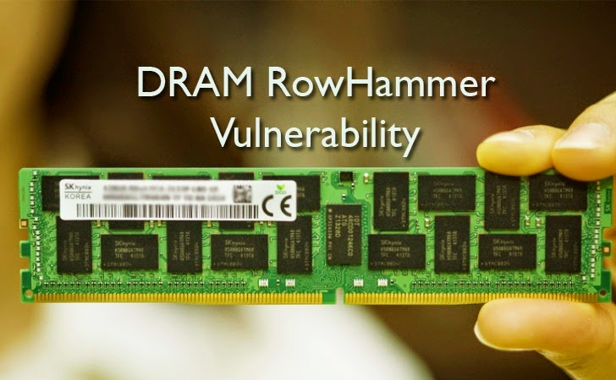
Rowhammer flips bits in your memory!
UC Berkeley EECS Sr Lecturer SOE Dan Garcia
The Beauty and Joy of Computing Lecture #14
Global Impact of Computing II
Google’s researchers have shown a technique for compromising a user’s computer using a memory flaw. It flips the bits in adjacent memory rows and the charge that leaks out of those rows makes the middle row flip sometimes!
www.wired.com/2015/03/google-hack-dram-memory-electric-leaks

Slide 2
Computing Enables Innovation

Slide 3
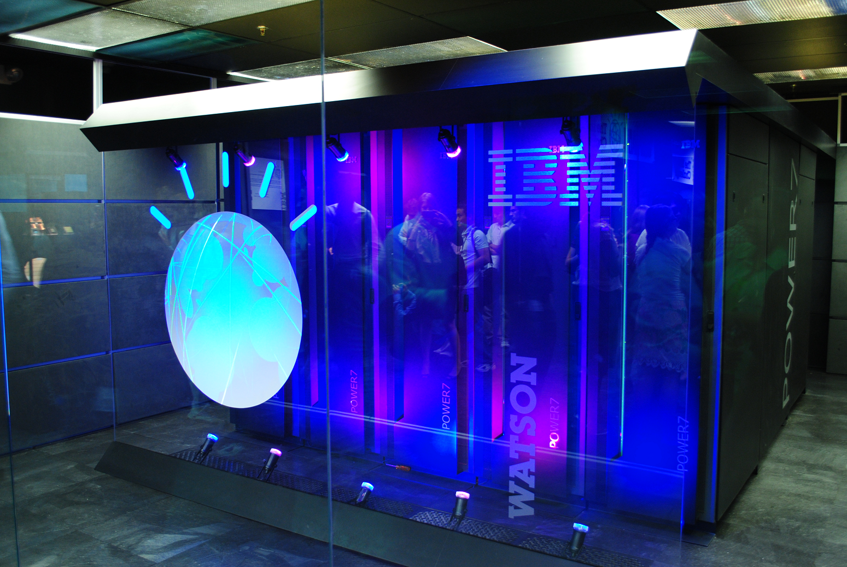
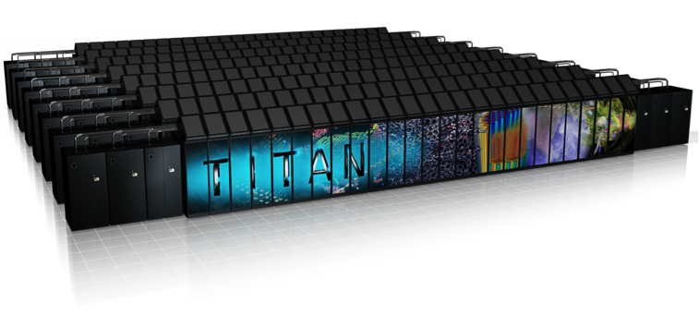
Computing Enables Innovation I
(in nearly
every field)
Machine learning and data mining have enabled innovation in medicine, business, and science.
Scientific computing has enabled innovation in science and business.
Computing enables innovation by providing the ability to access and share information.
Open and curated scientific databases have benefited scientific researchers.
IBM Watson (Image by Clockready, Wikipedia)
Titan Supercomputer. Courtesy of Oak Ridge National Laboratory, U.S. Dept. of Energy

Slide 4
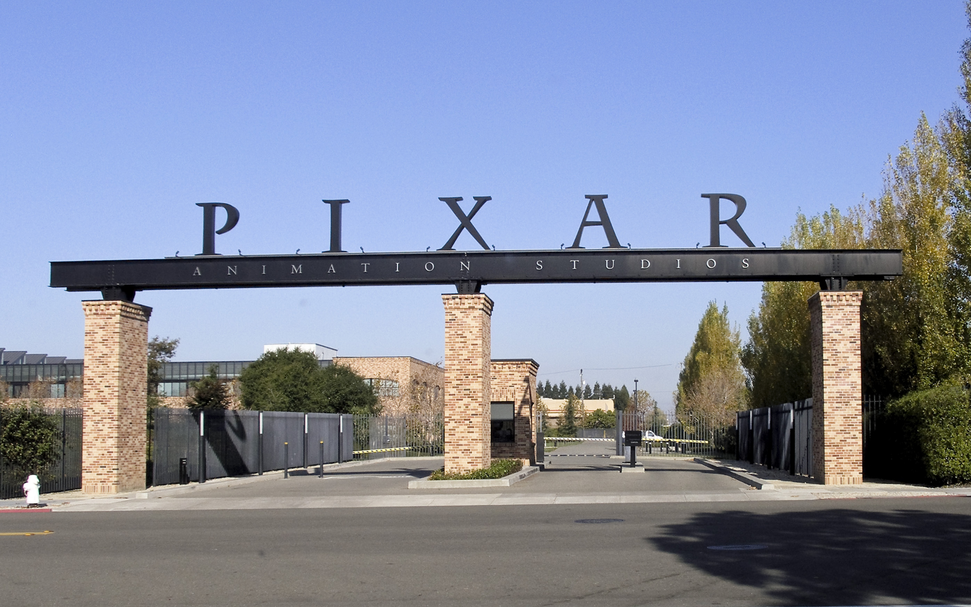
Computing Enables Innovation II
(in nearly
every field)
Moore’s law has encouraged industries that use computers to effectively plan future research and development based on anticipated increases in computing power.
Advances in computing as an enabling technology have generated and increased the creativity in other fields.
Moore’s Law (Image by Loadmaster, Wikipedia)
Pixar Studios (Image by Coolcaesar, Wikipedia)
☑

Slide 5
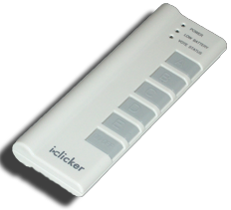
(Cal) Question (thanks to BH)
Music on your portable player: Where do you get it?
I paid to download everything on my iPod
I bought everything, as a download or ripped from CD/DVD
I bought most of my music but there are a few exceptions
I bought a little of my music, but most of it I didn’t buy
It’s all from Limewire / BitTorrent / friends / etc
Notes:
Answer: D (includes everything in which the computer poses a question and you have to answer in a computer-readable form, which so far means multiple choice)

Slide 6
Economic, Social, Cultural Contexts

Slide 7

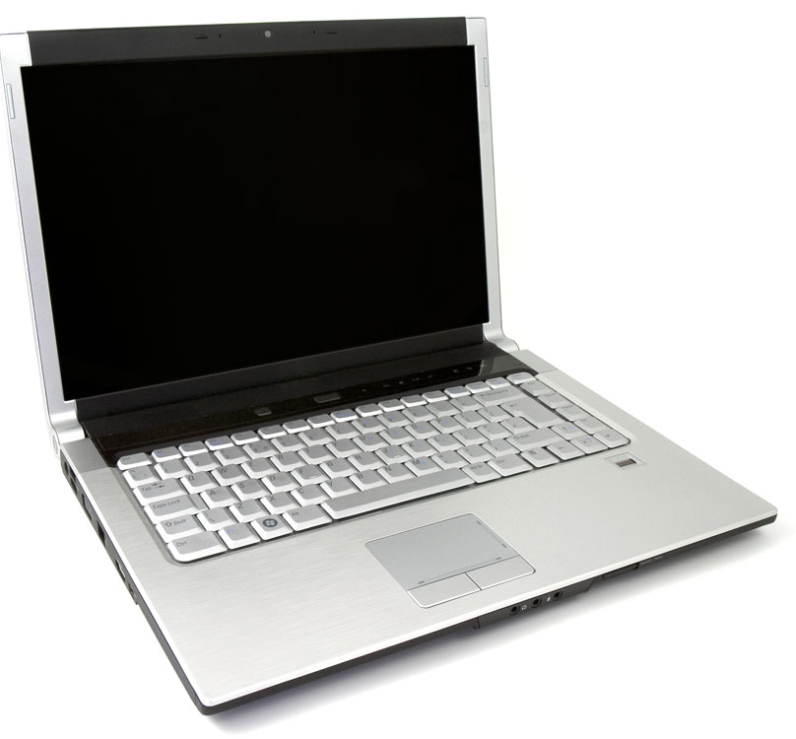
Economic, Social, Cultural Contexts I
Computing innovations influence and are influenced by the economic, social, and cultural contexts in which they are designed and used!
Laptop (Image by Petr Kratochvil, publicdomainpictures.net)

Slide 8
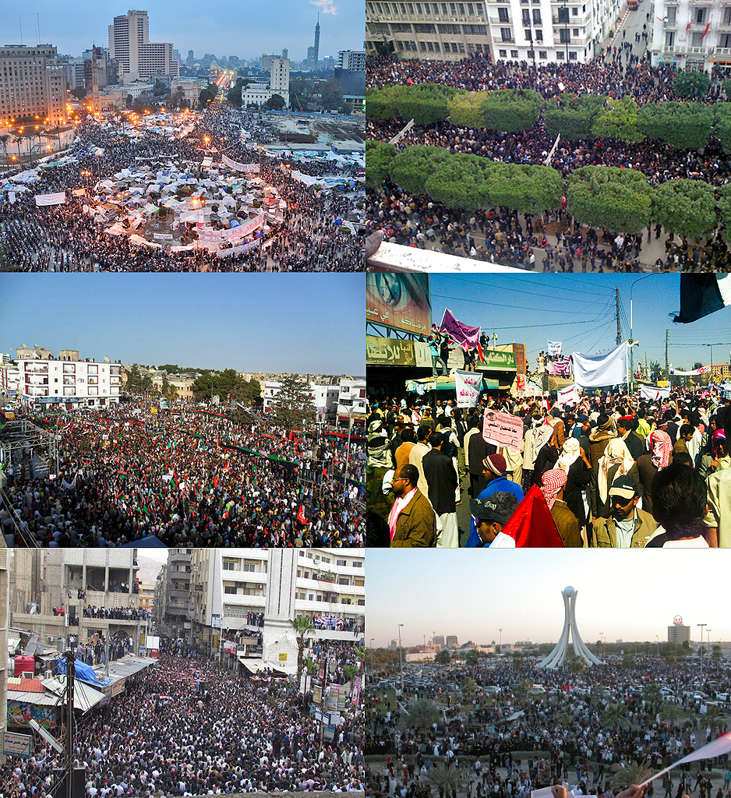
Economic, Social, Cultural Contexts II
Mobile, wireless, and networked computing have an impact on innovation throughout the world.
Networks and infrastructure are supported by both commercial and governmental initiatives.
The innovation and impact of social media and online access varies in different countries and in different socioeconomic groups.
Arab Spring (Image by Soerfm, Wikipedia)

Slide 9
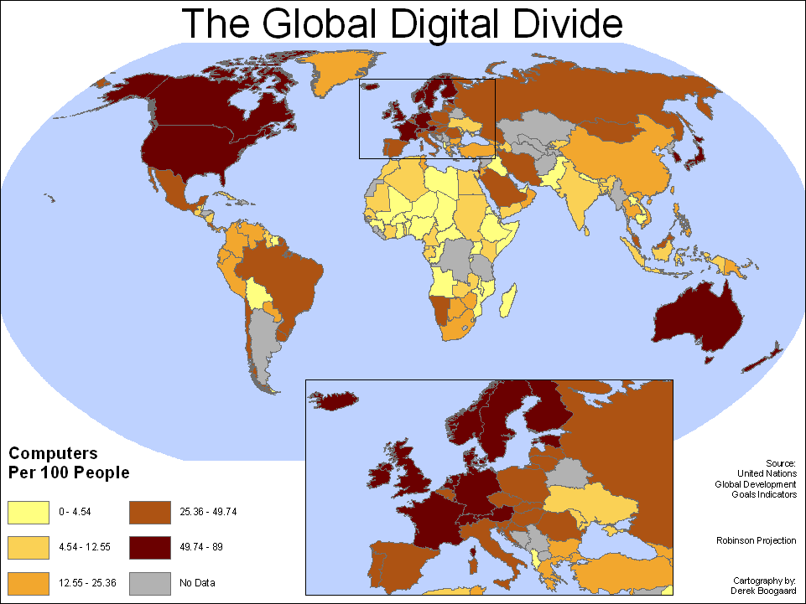
Economic, Social, Cultural Contexts III
internet.org
The global distribution of computing resources raises issues of equity, access, and power.
Groups and individuals are affected by the “digital divide” — differing access to computing and the Internet based on socioeconomic or geographic characteristics.
Global Digital Divide (Public Domain)
☑

Slide 10
(Cal) Question
The best way to help with the Digital Divide is…
Free iPads for all kids
More computers in libraries
Free wifi for communities
One Laptop Per Child
Old school talking to people in their houses.
Notes:
Answer: D (includes everything in which the computer poses a question and you have to answer in a computer-readable form, which so far means multiple choice)

Slide 11
Intellectual Property

Slide 12

Intellectual Property via Copyright
en.wikipedia.org/wiki/Copyright_Term_Extension_Act
copyright.gov
Brian Harvey:
“We’re going to make a bargain with creators. We’re going to give you a limited time monopoly to profit from your idea in return for sharing your idea with us. …
Congress keeps extending the duration of copyright”
US Constitution, Article I, Section 8:
“The Congress shall have power… to promote the Progress of Science and useful Arts, by securing for limited Times to Authors and Inventions the exclusive Right to their respective Writings and Discoveries.”
Logo for opposition to CTEA

Slide 13
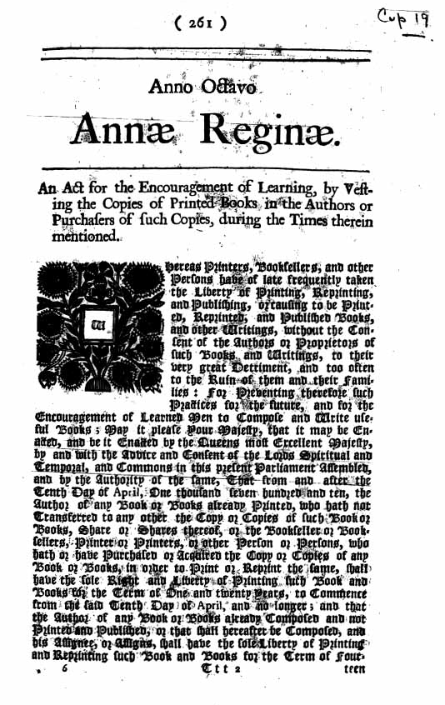
Economic, Social, Cultural Contexts I
en.wikipedia.org/wiki/Digital_Millennium_Copyright_Act
Widespread access to digitized information raises questions about intellectual property.
Creation of digital audio, video, and textual content by combining existing content has been impacted by copyright concerns.
The Digital Millennium Copyright Act (DMCA) has been a benefit and a challenge in making copyrighted digital material widely available.
The Statute of Anne, the origin of modern Copyright law, from 1710 (Public Domain)

Slide 14
First Illegal Prime Number
en.wikipedia.org/wiki/Illegal_prime
4 85650 78965 73978 29309 84189 46942 86137 70744 20873 51357 92401 96520 73668 69851 34010 47237 44696 87974 39926 11751 09737 77701 02744 75280 49058 83138 40375 49709 98790 96539 55227 01171 21570 25974 66699 32402 26834 59661 96060 34851 74249 77358 46851 88556 74570 25712 54749 99648 21941 84655 71008 41190 86259 71694 79707 99152 00486 67099 75923 59606 13207 25973 79799 36188 60631 69144 73588 30024 53369 72781 81391 47979 55513 39994 93948 82899 84691 78361 00182 59789 01031 60196 18350 34344 89568 70538 45208 53804 58424 15654 82488 93338 04747 58711 28339 59896 85223 25446 08408 97111 97712 76941 20795 86244 05471 61321 00500 64598 20176 96177 18094 78113 62200 27234 48272 24932 32595 47234 68800 29277 76497 90614 81298 40428 34572 01463 48968 54716 90823 54737 83566 19721 86224 96943 16227 16663 93905 54302 41564 73292 48552 48991 22573 94665 48627 14048 21171 38124 38821 77176 02984 12552 44647 44505 58346 28144 88335 63190 27253 19590 43928 38737 64073 91689 12579 24055 01562 08897 87163 37599 91078 87084 90815 90975 48019 28576 84519 88596 30532 38234 90558 09203 29996 03234 47114 07760 19847 16353 11617 13078 57608 48622 36370 28357 01049 61259 56818 46785 96533 31007 70179 91614 67447 25492 72833 48691 60006 47585 91746 27812 12690 07351 83092 41530 10630 28932 95665 84366 20008 00476 77896 79843 82090 79761 98594 93646 30938 05863 36721 46969 59750 27968 77120 57249 96666 98056 14533 82074 12031 59337 70309 94915 27469 18356 59376 21022 20068 12679 82734 45760 93802 03044 79122 77498 09179 55938 38712 10005 88766 68925 84487 00470 77255 24970 60444 65212 71304 04321 18261 01035 91186 47666 29638 58495 08744 84973 73476 86142 08805 29443

Slide 15

Economic, Social, Cultural Contexts II
Legal and Ethical concerns are raised by
Innovations enabled by computing
Authenticated and anonymous access to digital information
Commercial and governmental censorship of digital information
Open source and licensing of software and content
Commercial access to music and movie downloads and streaming
Access to digital content via peer-to-peer networks

Slide 16
Creative Commons
creativecommons.org
A GREAT way to share / remix / reuse content
Legal!
Set of licenses
Website for sharing CC content
Open access and Creative Commons have enabled broad access to digital information.
BY = Attribution | Share Alike | No Derivs | Non Commercial
CC BY
CC BY SA | x
CC BY ND |  | x
CC BY NC |  |  | x
CC BY NC SA | x |  | x
CC BY NC ND |  | x | x

